Slide 1
Machine learning in political science
Eago, Kai Yang
Assistant Professor
Dept of Government and Public Administration
Lingnan University, HK
February 12, 2025

Slide 2
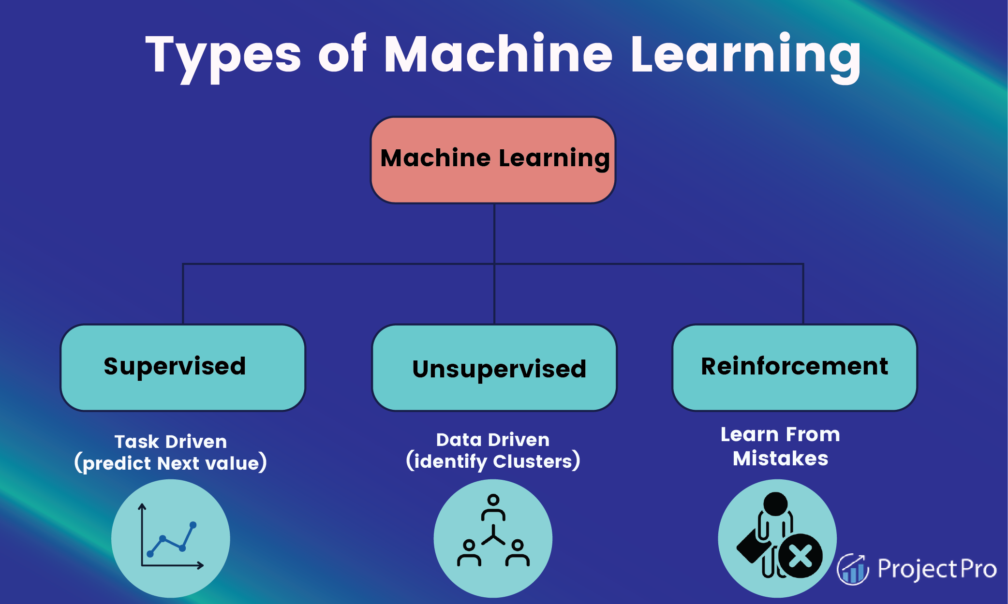
Machine learning
Notes:
https://www.projectpro.io/article/types-of-machine-learning/623

Slide 3
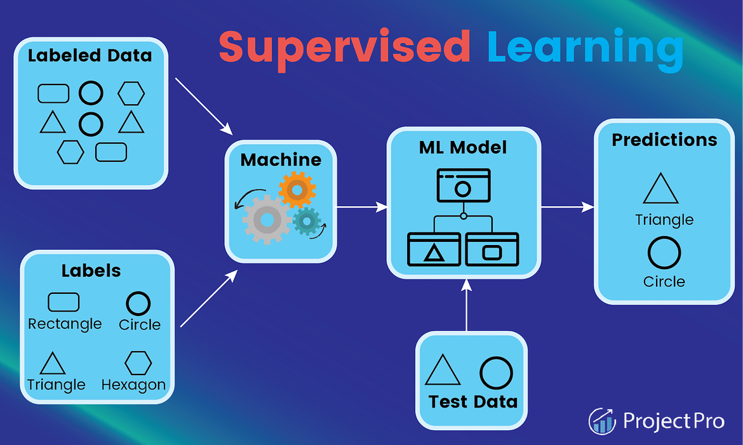
I. Supervised Learning Algorithms

Slide 4
1.1 classification
Predicts the label of a class
Predict the dataset's categories
Example: "Yes" or "No“
Commonly Used Algorithms:
Decision Tree Algorithm
Logistic Regression
Random Forest Algorithm
Support Vector Machine Algorithm

Slide 5
1.2 regression
Predicts the numerical label/continuous variables
Example: weather prediction
Commonly used algorithms:
Decision Tree Algorithm
Lasso Regression
Multivariate Regression Algorithm
Simple Linear Regression Algorithm

Slide 6
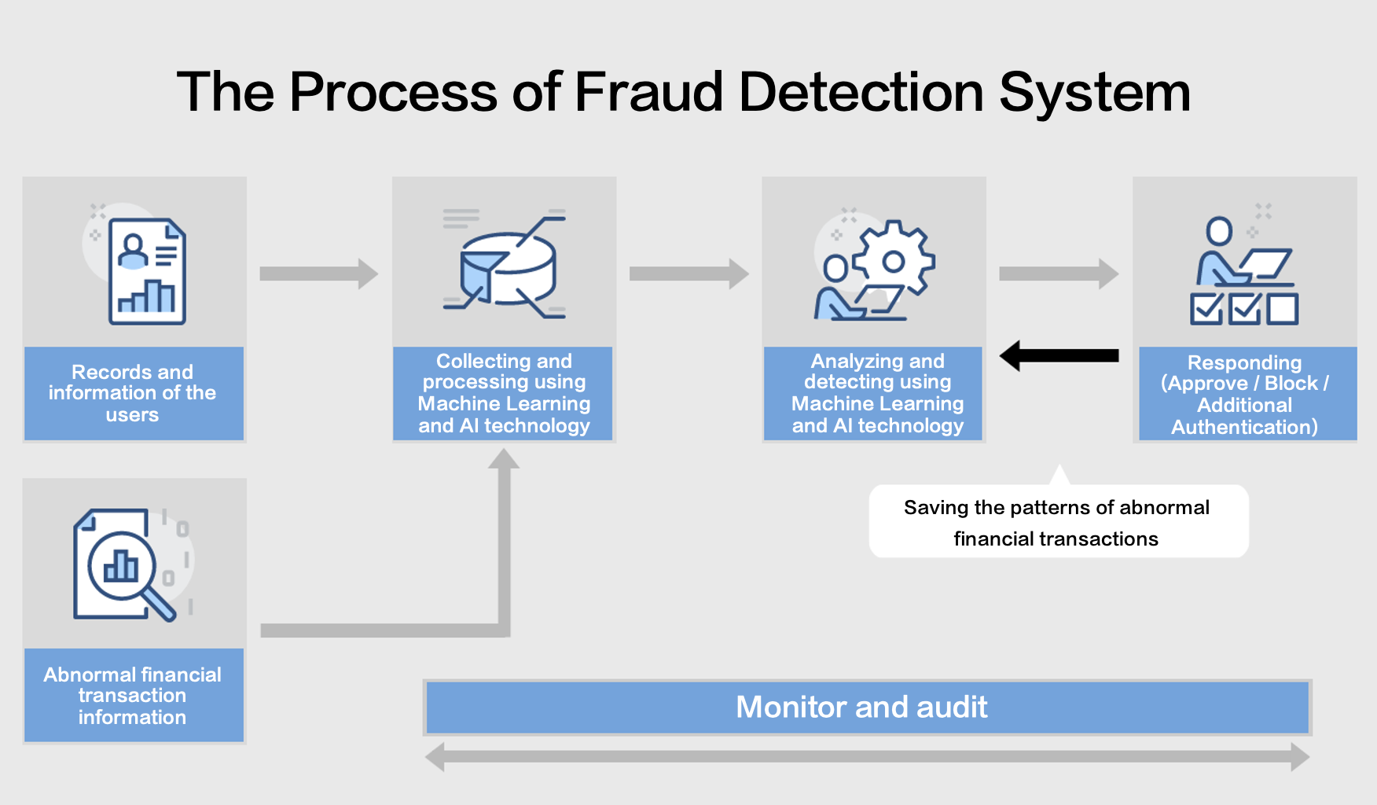
Application I: Fraud detection
Notes:
https://www.pentasecurity.com/blog/fraud-detection-system-fds-with-ai-technology/

Slide 7

Application II: Image Segmentation
Notes:
https://medium.datadriveninvestor.com/deep-learning-for-image-segmentation-d10d19131113

Slide 8
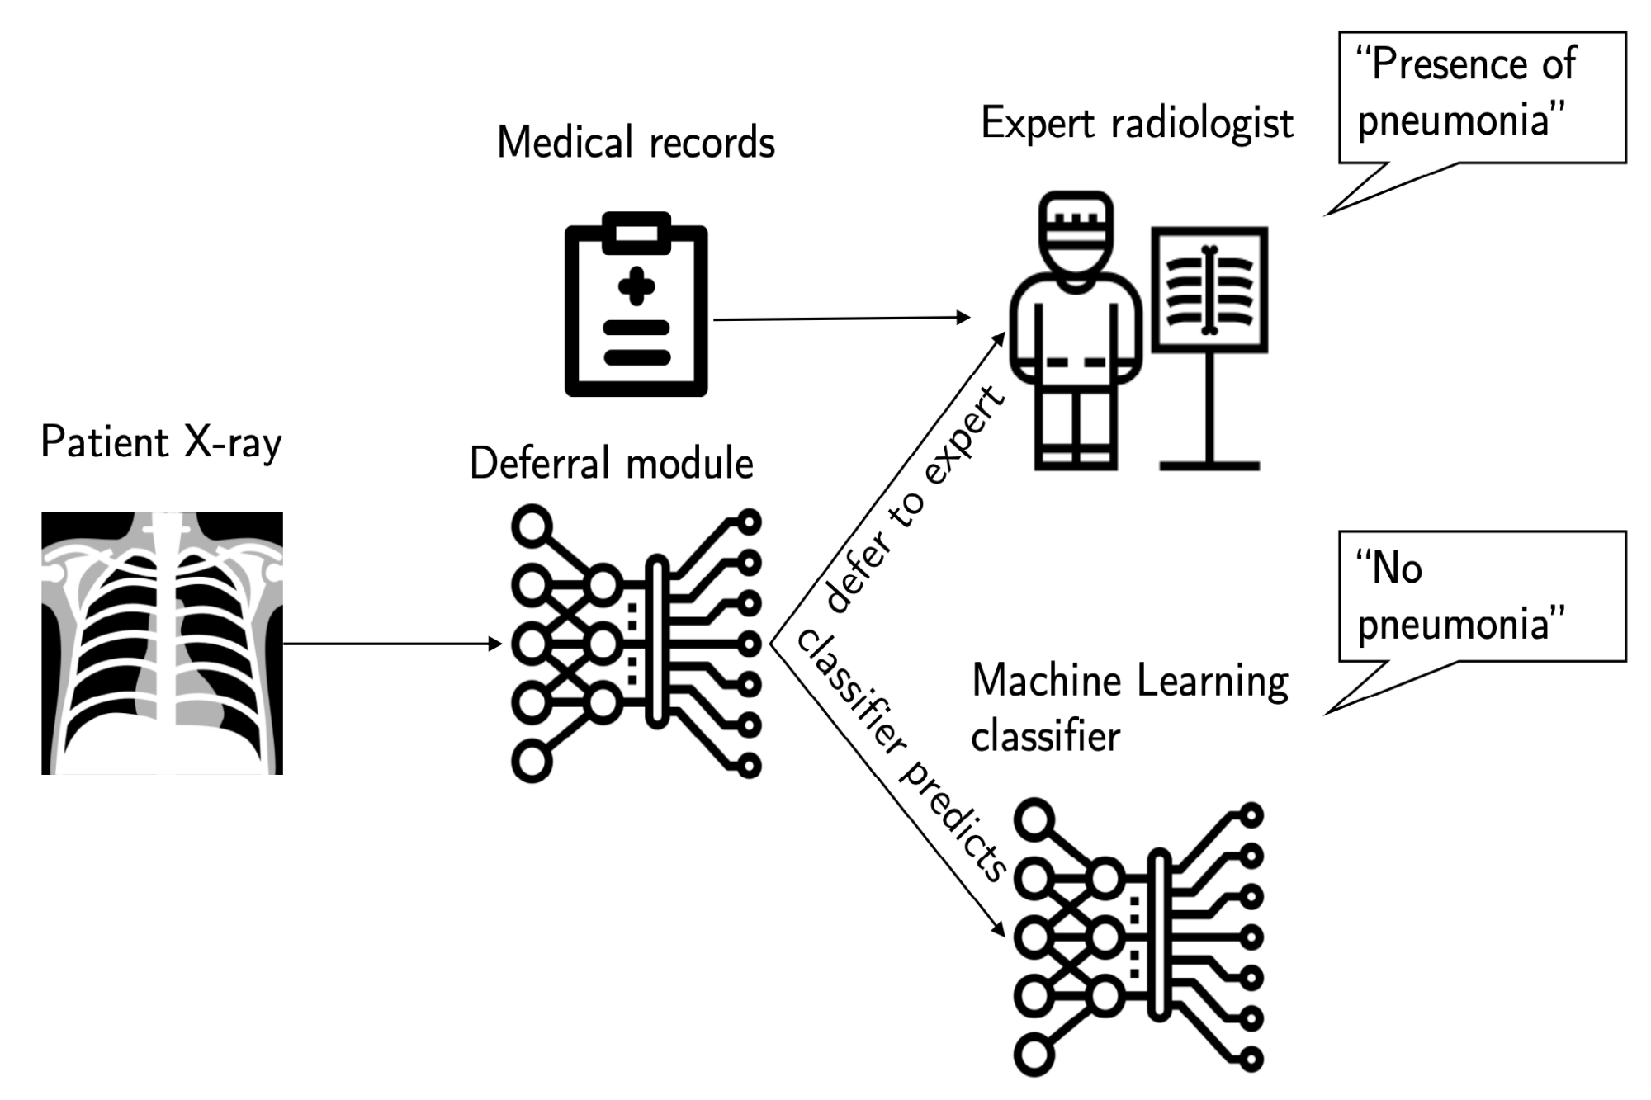
Application III: Medical Diagnosis
Notes:
https://news.mit.edu/2020/machine-learning-health-care-system-understands-when-to-step-in-0731

Slide 9
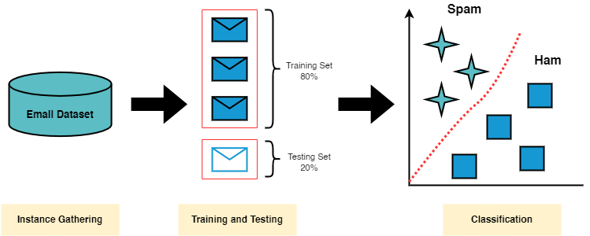
Application IV: Spam Detection
Notes:
https://medium.com/@alinatabish/machine-learning-techniques-for-spam-detection-in-email-7db87eb11bc2

Slide 10
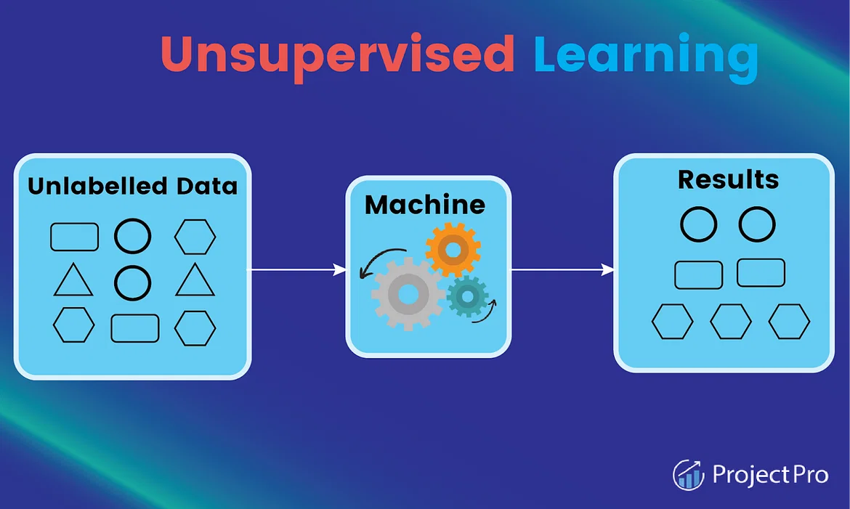
2. unSupervised Learning Algorithms

Slide 11
2.1 association
Finds relations between variables in a large dataset
Goal: discover and map data dependent on the other to produce maximum profit
Example: web usage mining
Commonly used algorithms:
Apriori algorithm
Eclat
FP-growth algorithm

Slide 12
2.2 clustering
A method of grouping each set of similar objects into a cluster
Goal: discover inherent groups from the dataset
Example: retail marketing
Commonly used algorithms:
K-Means Clustering Algorithm
DBSCAN Algorithm
Independent Component Analysis
Mean-Shift Algorithm
Principal Component Analysis

Slide 13
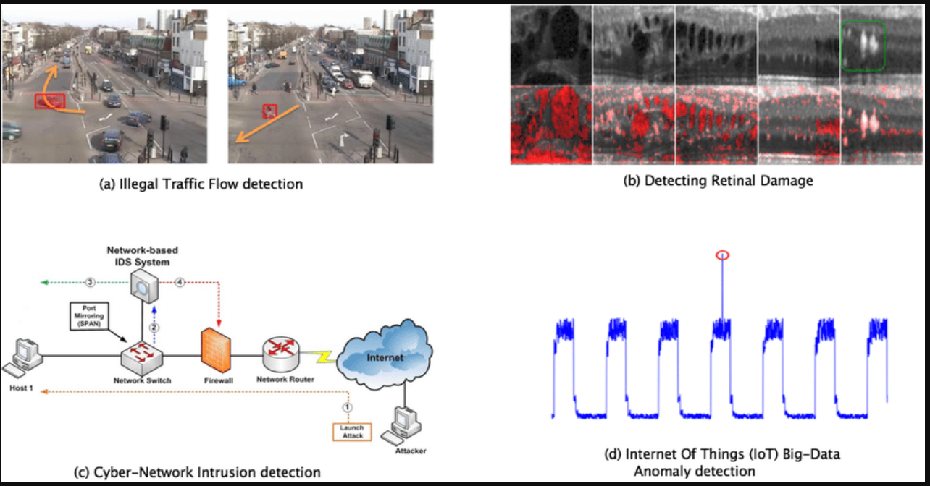
Application I: Anomaly Detection
Notes:
https://medium.com/abacus-ai/real-time-anomaly-detection-a-deep-learning-approach-99ac28d0ac98

Slide 14
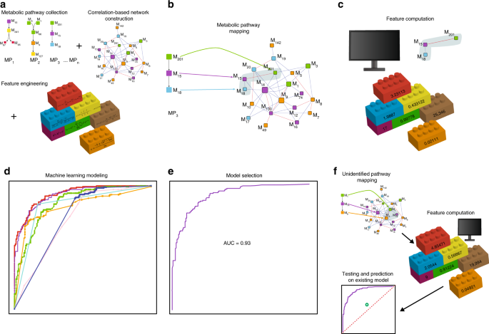
Application II: network analysis
Notes:
https://www.nature.com/articles/s42003-019-0440-4

Slide 15
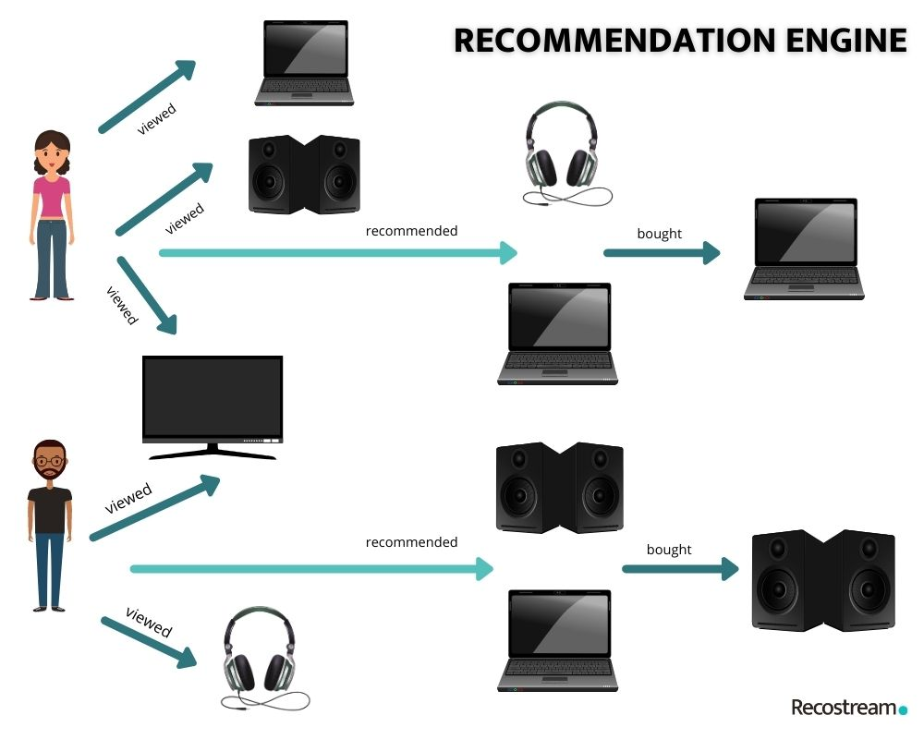
Application III: Recommendation Systems
Notes:
https://stratoflow.com/machine-learning-recommendation-engine/

Slide 16
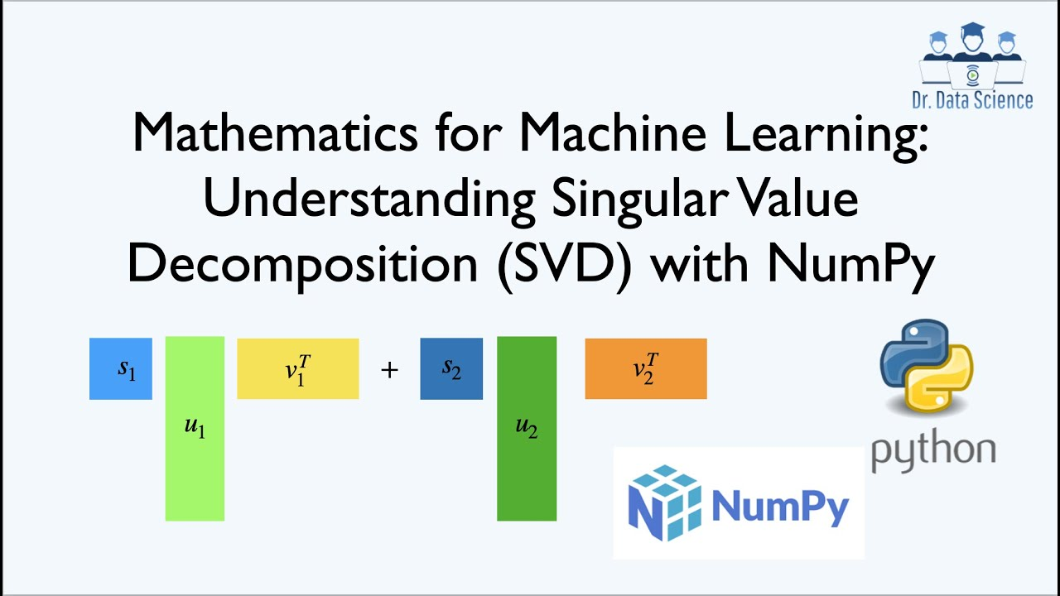
Application IV: Singular-Value Decomposition
Notes:
https://www.youtube.com/watch?v=5d67893GJao

Slide 17
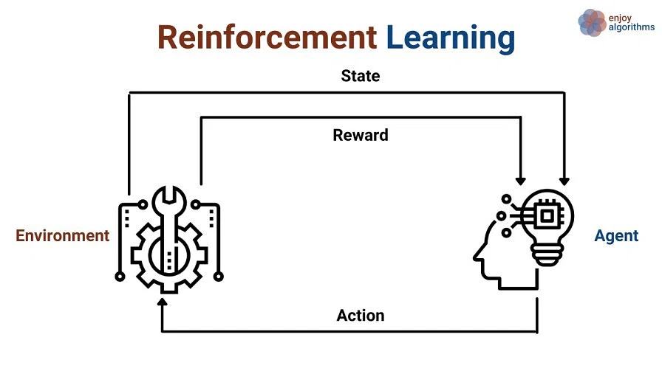
3. Reinforcement Learning Algorithms

Slide 18
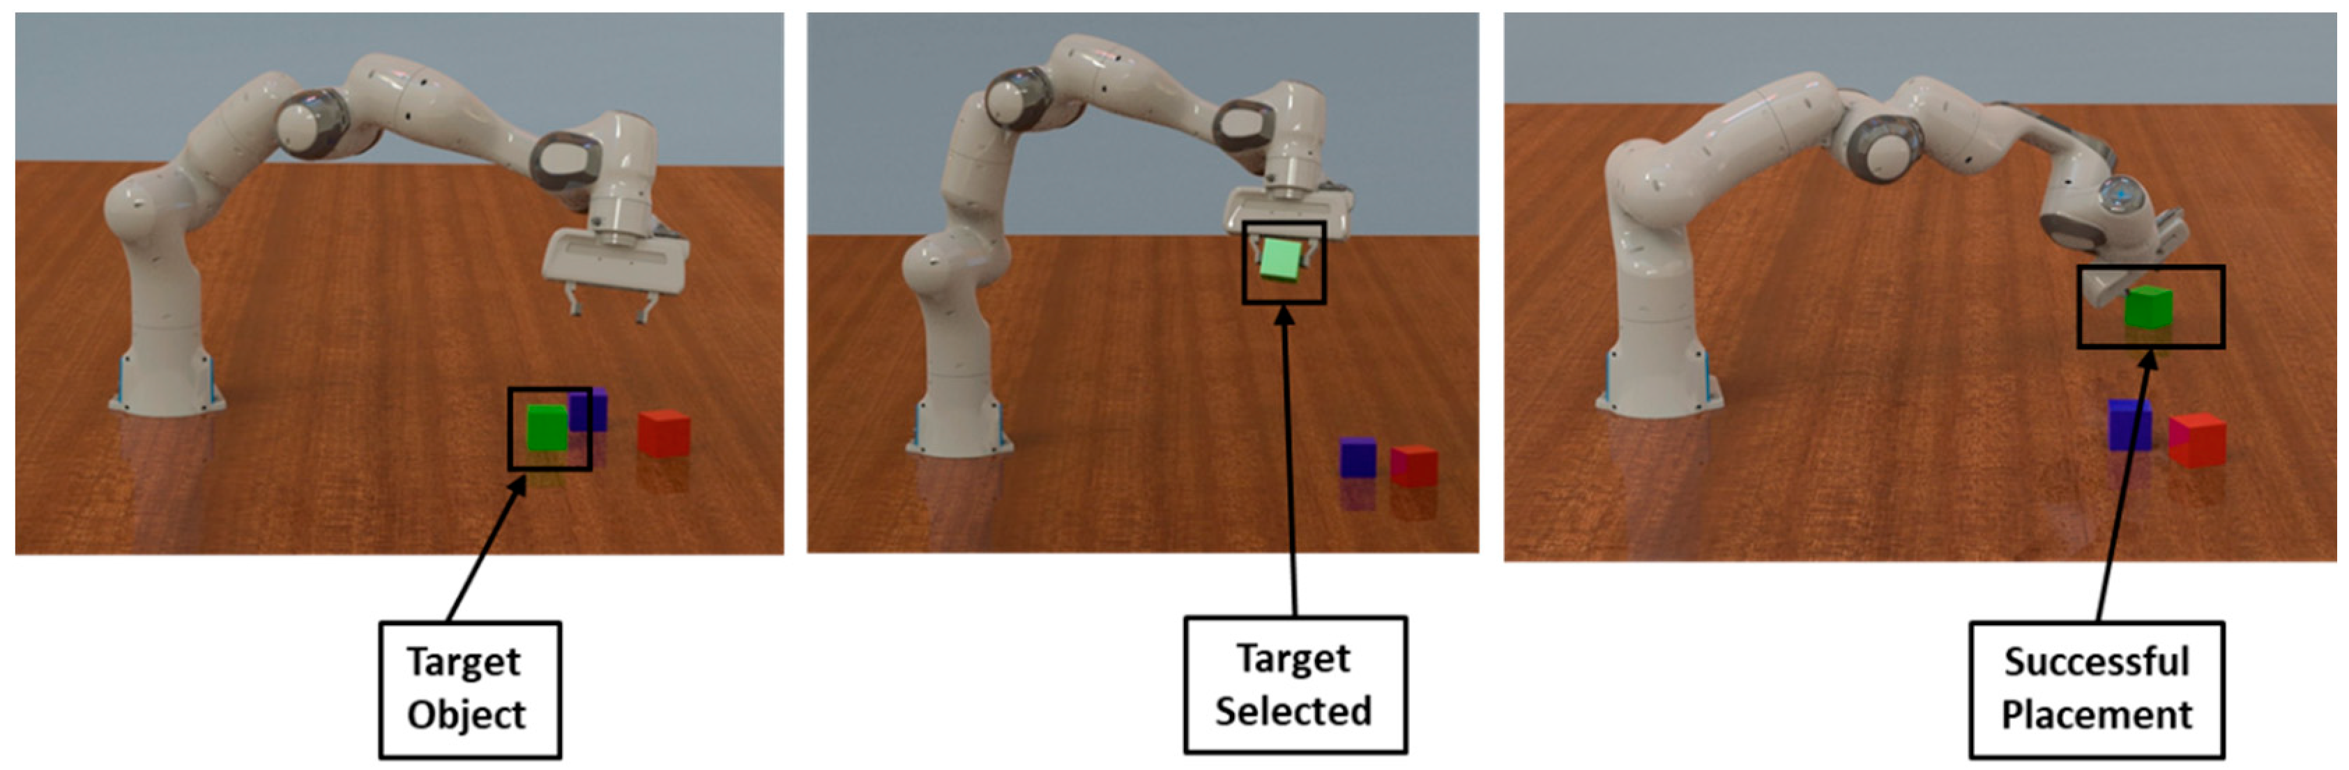
Application I: Robotics
Notes:
https://www.mdpi.com/2218-6581/10/3/105

Slide 19
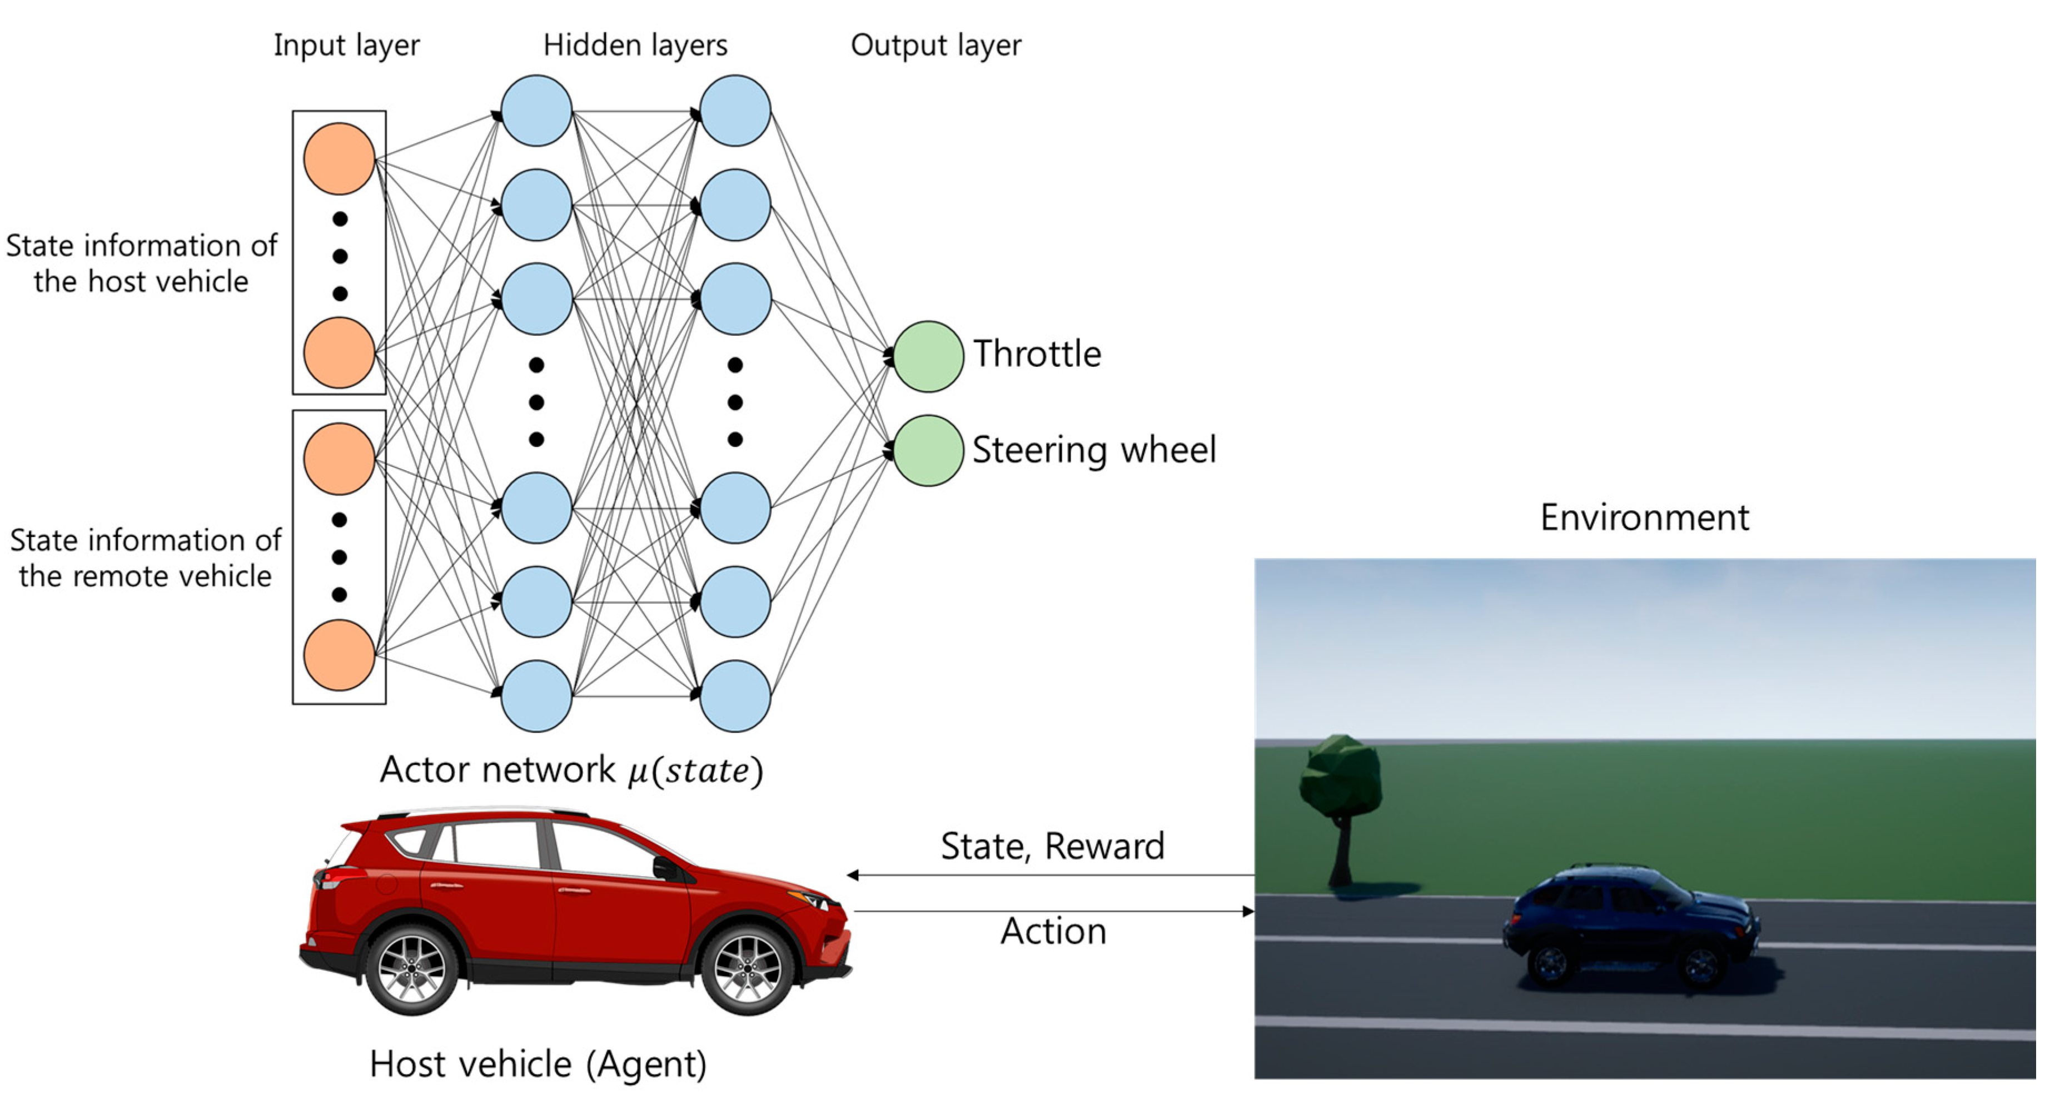
Application II: Self-driving Automobiles
Notes:
https://www.mdpi.com/2079-9292/8/5/543

Slide 20
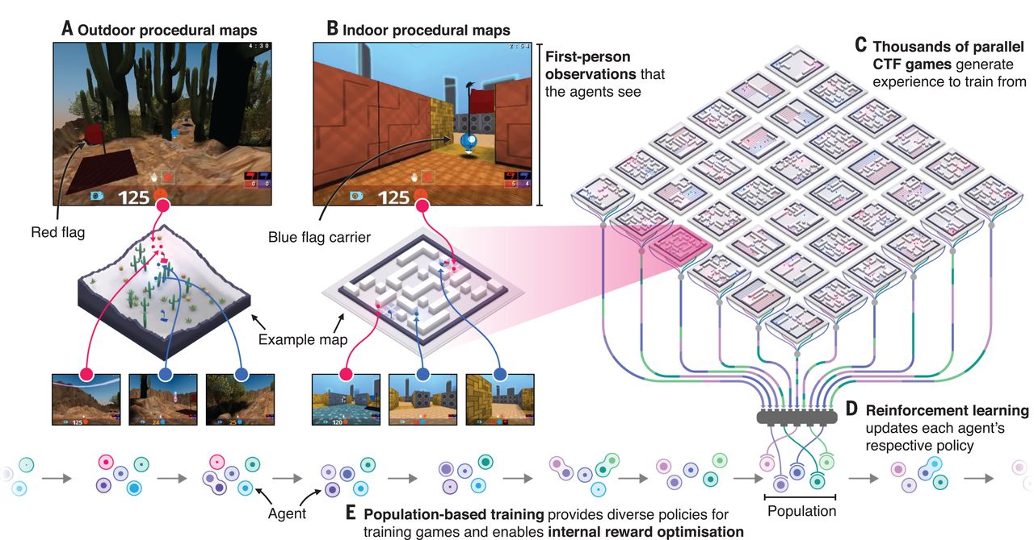
Application III: Video Games
Notes:
https://www.science.org/doi/10.1126/science.aau6249

Slide 21
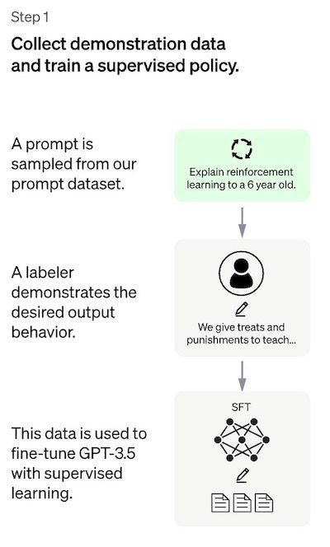
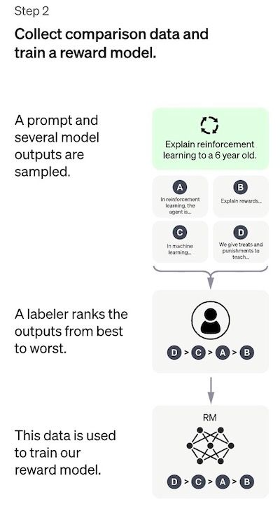
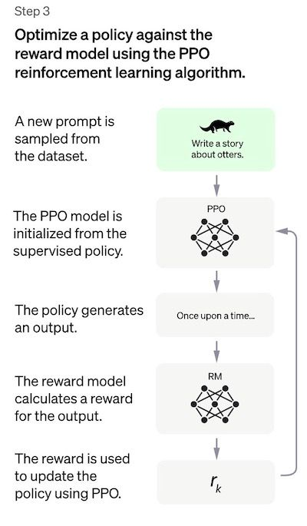
Application IV: Chatgpt
Notes:
https://www.assemblyai.com/blog/how-chatgpt-actually-works/

Slide 22
Introduction to the Virtual Issue: Machine Learning in Political Science
https://www.cambridge.org/core/services/aop-file-manager/file/5c348274e401b41903dae11b/PAN-VSI-Intro-0119-Machine-learning.pdf
Machine Learning for Social Science: An Agnostic Approach
https://www.annualreviews.org/doi/pdf/10.1146/annurev-polisci-053119-015921?download=true

Slide 23
Reference list
Brady, Henry E., and David Collier, eds. Rethinking social inquiry: Diverse tools, shared standards. Rowman & Littlefield Publishers, 2010.
Creager A.N.H., Lunbeck, J., Wise, Matthew N. Science without laws: Model systems, cases, exemplary narratives. Duke University Press, 2007.
Goertz, Gary, and James Mahoney. A tale of two cultures: Qualitative and quantitative research in the social sciences. Princeton University Press, 2012.
Mahoney, James. "After KKV: The new methodology of qualitative research." World Politics 62, no. 1 (2010): 120-147.
Caldarelli, Guido, Alessandro Chessa, Fabio Pammolli, Gabriele Pompa, Michelangelo Puliga, Massimo Riccaboni, and Gianni Riotta. "A multi-level geographical study of Italian political elections from Twitter data." PloS one 9, no. 5 (2014): e95809.
Crosas, Merce, Gary King, James Honaker, and Latanya Sweeney. "Automating open science for big data." The ANNALS of the American Academy of Political and Social Science 659, no. 1 (2015): 260-273.
González-Bailón, Sandra, and Georgios Paltoglou. "Signals of public opinion in online communication: A comparison of methods and data sources." The ANNALS of the American Academy of Political and Social Science 659, no. 1 (2015): 95-107.
Salganik, Matthew J. Bit by bit: Social research in the digital age. Princeton University Press, 2018.
King, Gary, Robert O. Keohane, and Sidney Verba. Designing social inquiry: Scientific inference in qualitative research. Princeton university press, 1994.

